Slide 1
Lecture 16

Slide 2
the xsl:variable element
The format of the xsl:variable element is
  <xsl:variable name=qname select=expression/>
or
  <xsl:variable name=qname>
  <!-- Content: template -->
  </xsl:variable>
or
  <xsl:variable name=qname/>
It tells the XSLT processor to
  instantiate the variable with the given name to the value of the expression or to the value of the template or to the empty string
Later, the value of the variable can be accessed by an expression comprising $ followed by the name
xsl:variables are not mutable

Slide 3
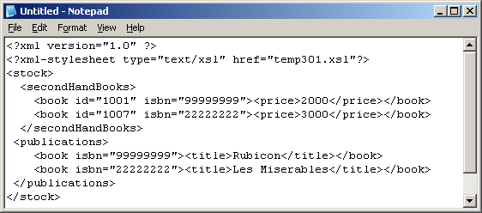
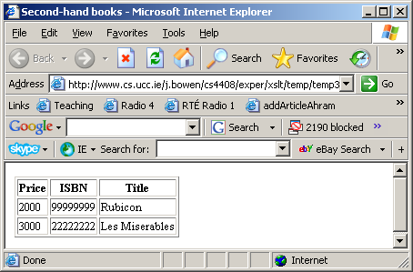
Example usage of the xsl:variable element
<?xml version="1.0"?>
<xsl:transform version="1.0" xmlns:xsl="http://www.w3.org/1999/XSL/Transform">
<xsl:template match="/">
<html> <head><title>Second-hand books</title></head> <body> <table rules="all">
<thead><tr><th>Price</th><th>ISBN</th><th>Title</th></tr></thead> <tbody>
<xsl:for-each select="./stock/secondHandBooks/book">
<xsl:variable name="thisISBN” select="./@isbn"/>
<tr><td><xsl:value-of select="price"/></td>
<td> <xsl:value-of select="$thisISBN"/> </td><td>
<xsl:value-of select="/stock/publications/book[@isbn=$thisISBN]/title"/></td></tr>
</xsl:for-each>
</tbody> </table></body></html> </xsl:template> </xsl:transform>

Slide 4
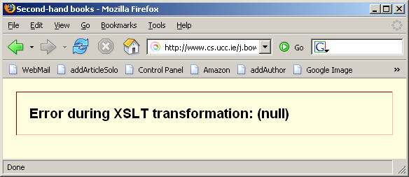
The scope of an xsl:variable element
<?xml version="1.0"?>
<xsl:transform version="1.0" xmlns:xsl="http://www.w3.org/1999/XSL/Transform">
<xsl:template match="/">
<html> <head><title>Second-hand books</title></head> <body> <table rules="all">
<thead><tr><th>Price</th><th>ISBN</th><th>Title</th></tr></thead> <tbody>
<xsl:for-each select="./stock/secondHandBooks/book">
<tr> <td><xsl:variable name="thisISBN” select="./@isbn"/>
<xsl:value-of select="price"/></td>
<td> <xsl:value-of select=”$thisISBN "/> </td><td>
<xsl:value-of select="/stock/publications/book[@isbn=$thisISBN]/title"/></td></tr>
</xsl:for-each></tbody> </table></body></html> </xsl:template> </xsl:transform>
Scope of an xsl:variable is the element within which it was declared

Slide 5
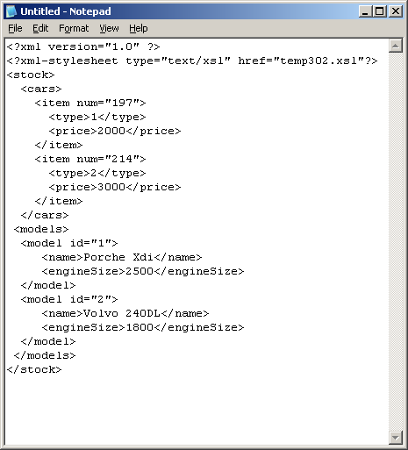
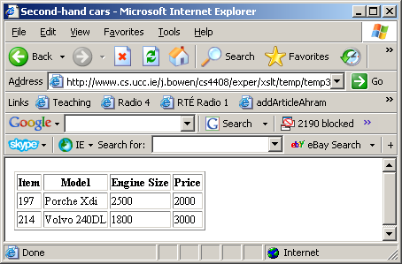
Another cross-referencing example
The type of an item refers to the id of a car model
To produce the HTML table, we use an xsl:variable to remember an item’s type and search for model containing this id in the set of models

Slide 6
The XSL stylesheet for previous slide
<?xml version="1.0"?>
<xsl:transform version="1.0" xmlns:xsl="http://www.w3.org/1999/XSL/Transform">
<xsl:template match="/">
<html> <head><title>Second-hand cars</title></head> <body> <table rules="all">
<thead><tr><th>Item</th><th>Model</th><th>Engine Size</th><th>Price</th></tr></
thead> <tbody>
<xsl:for-each select="./stock/cars/item">
<xsl:variable name="thisType" select="./type"/>
<tr>
<td> <xsl:value-of select="./@num"/> </td>
<td> <xsl:value-of select="/stock/models/model[@id=$thisType]/name"/> </td>
<td> <xsl:value-of select="/stock/models/model[@id=$thisType]/engineSize"/> </td>
<td> <xsl:value-of select="./price"/> </td>
</tr>
</xsl:for-each>
</tbody> </table></body></html>
</xsl:template>
</xsl:transform>

